Slide 1
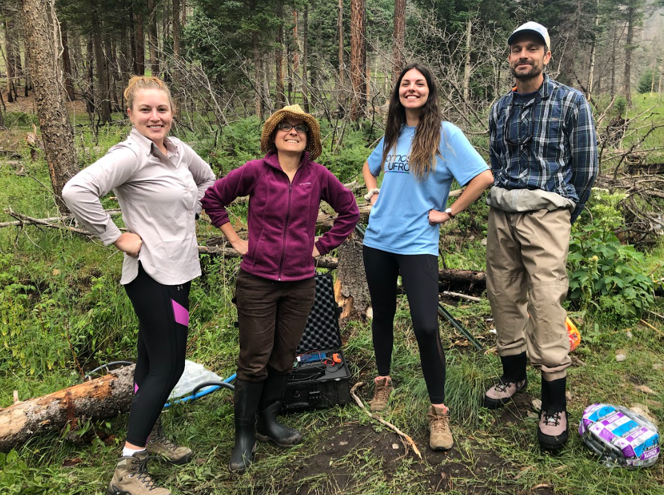
Introduction
My name is Nicole Hucke
4th year Civil Engineering PhD student at U of I
Came from Chile for grad school
Advisor is Dr. Elowyn Yager
Thank you for meeting with me ☺

Slide 2
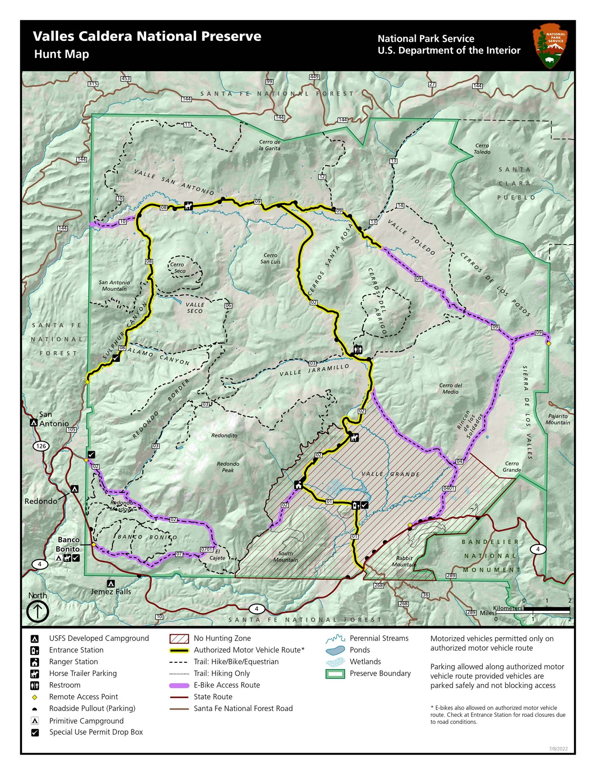
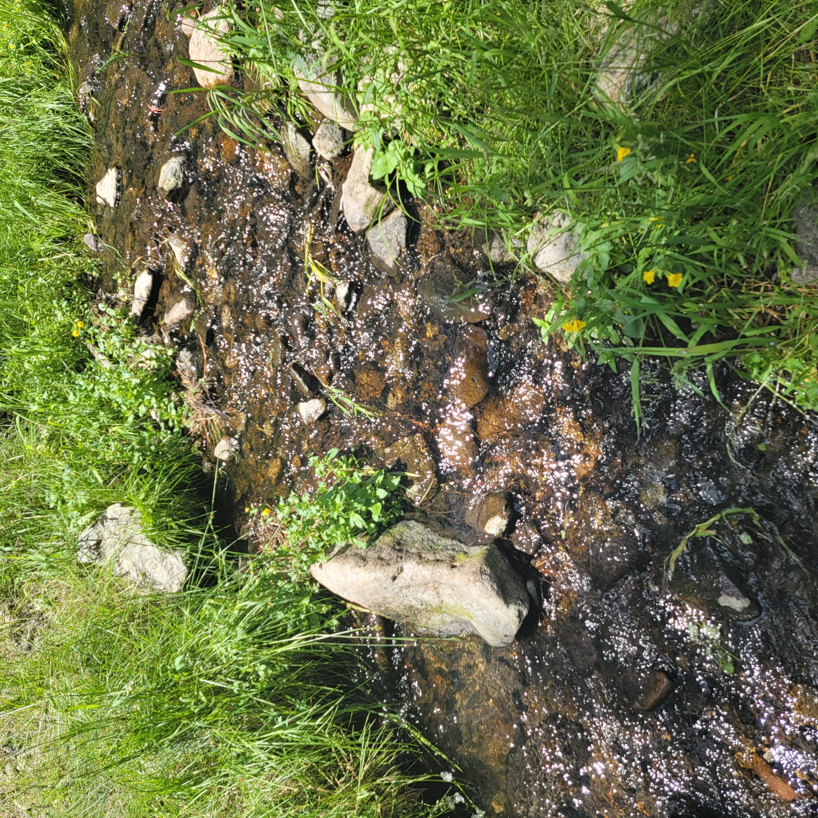
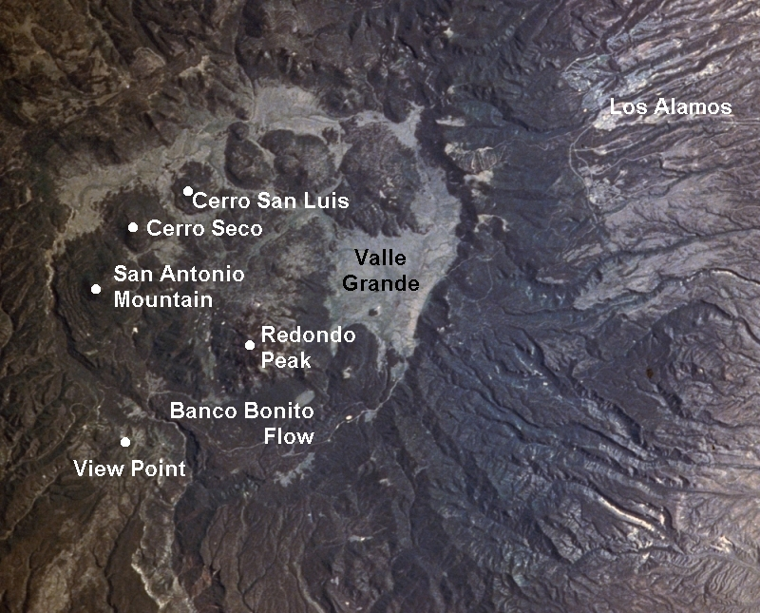
My field site: La Jara Creek – Valles Caldera National Preserve NM
An armored tributary of the East Fork Jemez River in the Valles Caldera National Preserve
Slope: 8-10%
Channel Width: 1 m
Equipment is in two reaches:
- Upwelling (kind of?)
- Downwelling
Measuring water column constituents during high flow events for these seasons:
- Summer 2021
- Summer 2022
- Spring 2023
- Summer 2023

Slide 3
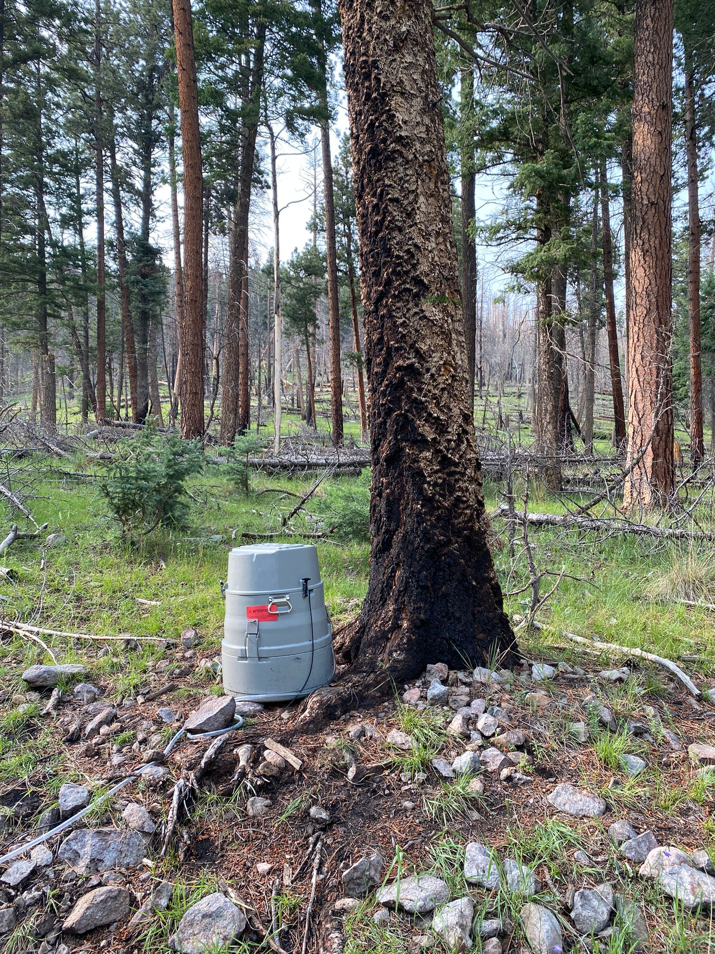
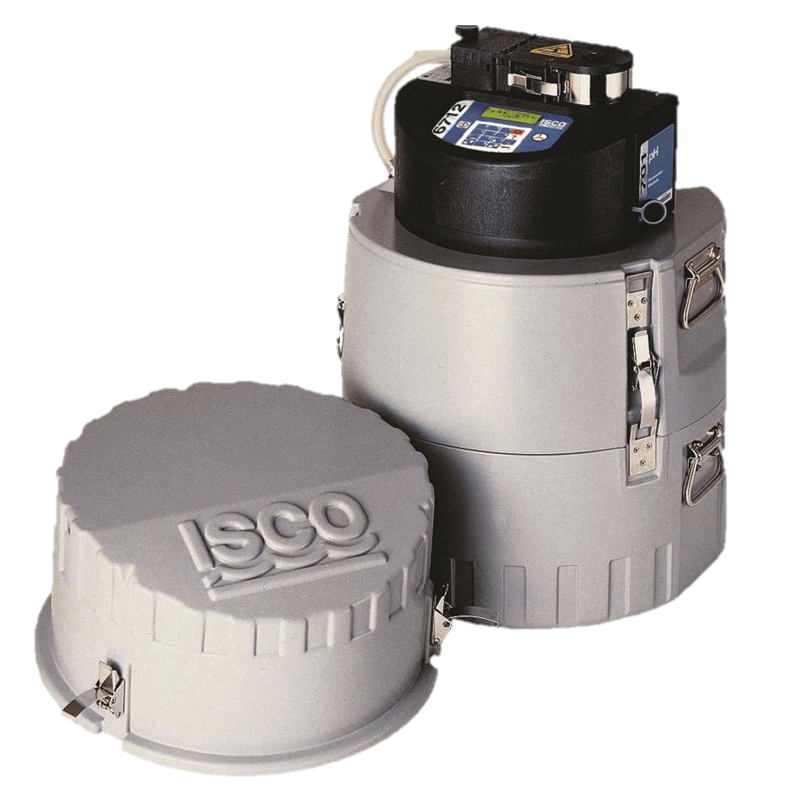
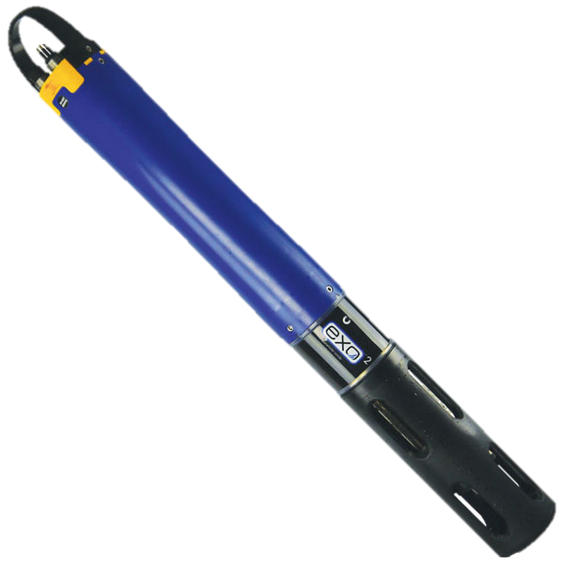
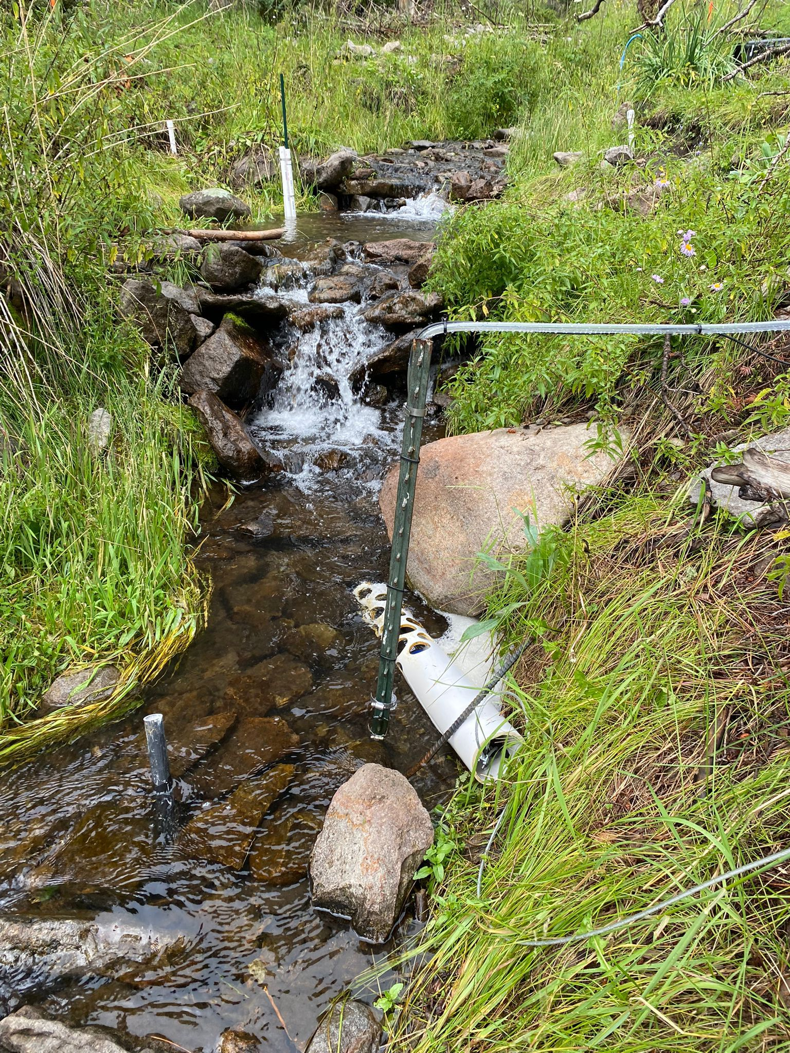

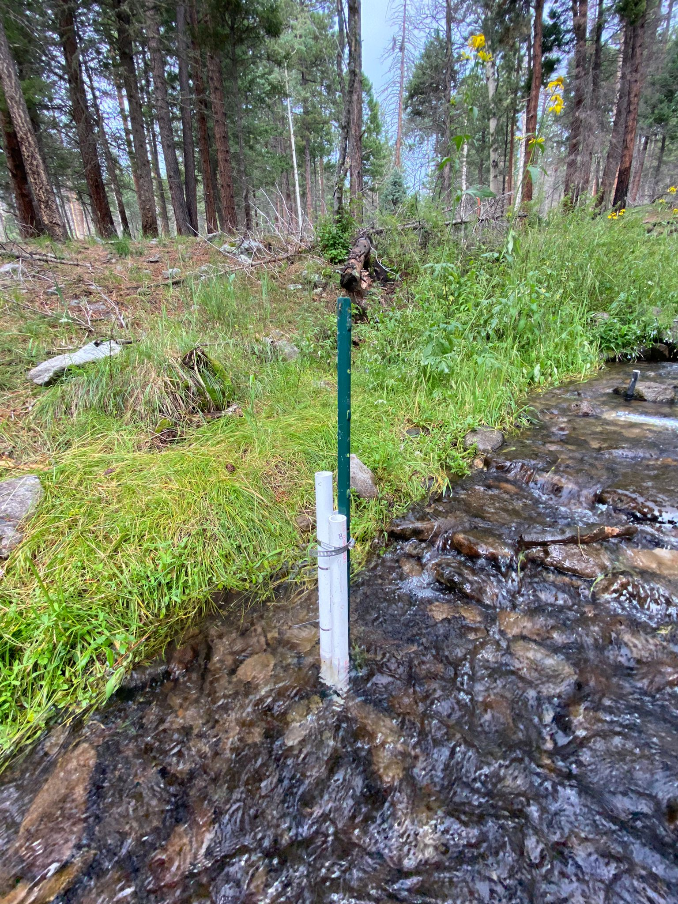
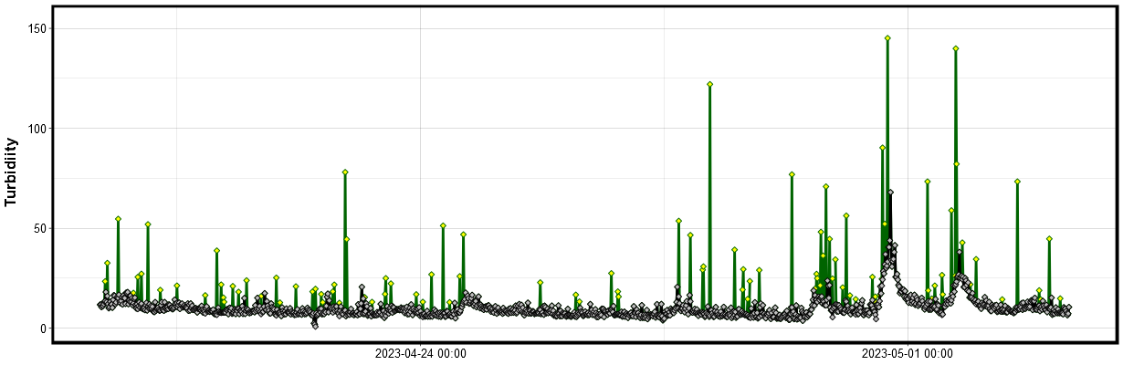
Deployed Equipment – Data collection for both reaches
Water samples (SS, SRP, POC & PP)
Collected through stage-triggered portable ISCO samplers
Turbidity
ISCO
Obtained with a YSI EXO2 Sonde
Flow depth and Discharge
Obtained through pressure transducers installed in stilling wells
Turbidity data cleanup using:
https://github.com/mayousif/Turbidity-Cleaner
Sonde
Piezometer
Nest

Slide 4
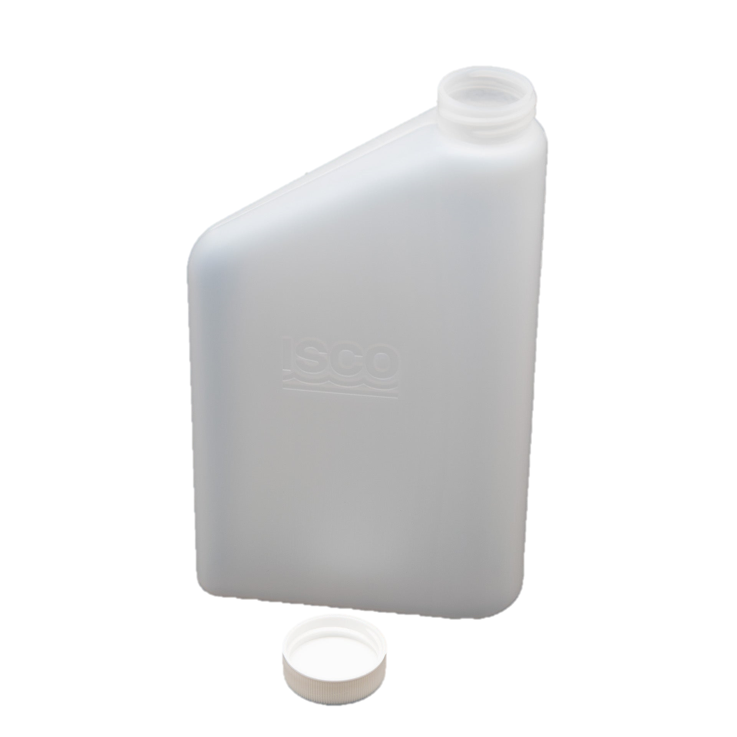

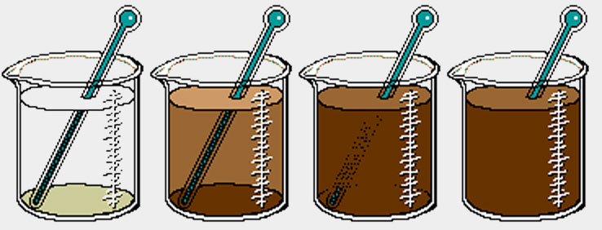
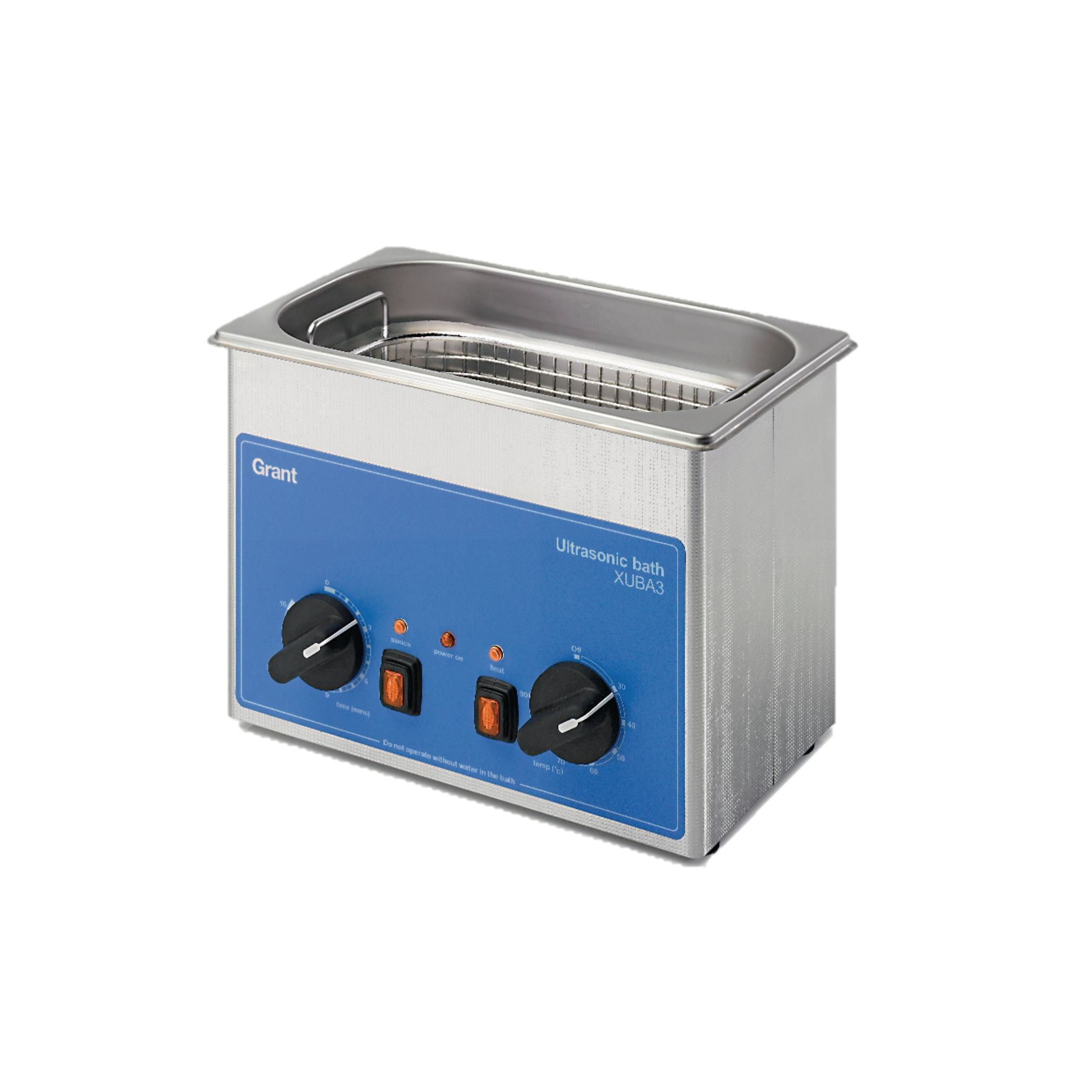

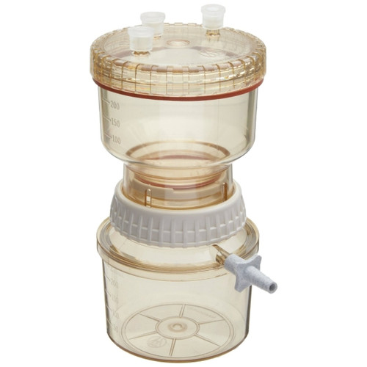
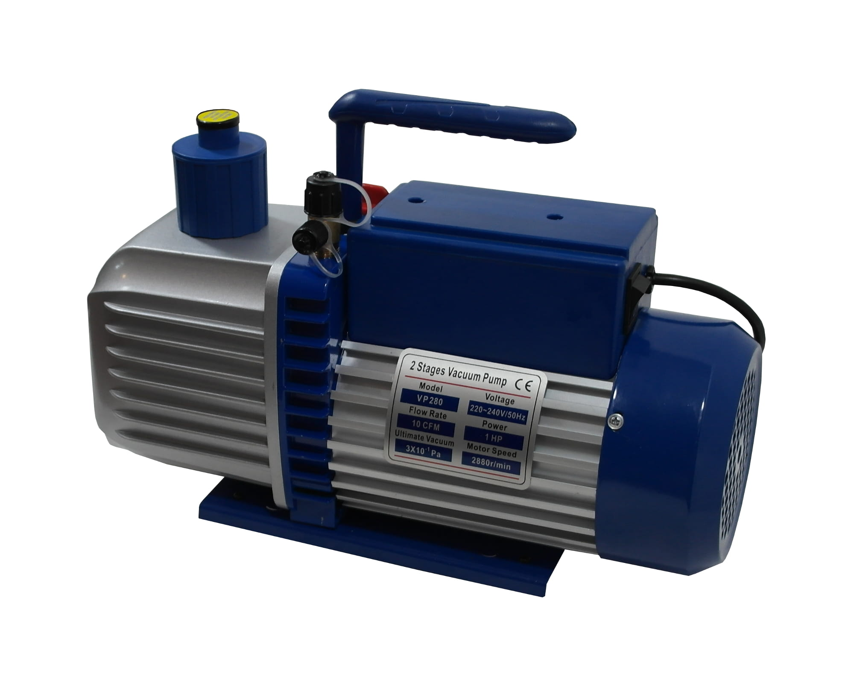
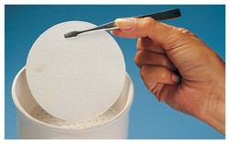
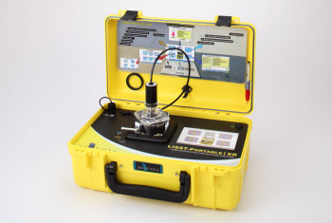
How did I get Suspended Sediment?
Method 1:
Laser diffraction method (LISST portable XR)
Method 2:
Filtering using Vacuum Pump
Using 47mm (diameter) glass fiber filters (pore size 0.4 μm), ISCO samples were filtered, and sediment was caught on the filter
ISCO sample
Ultrasonic bath to avoid agglomeration
This method give me a volumetric concentration in µL/L
$$post filter −initial filter=sediment weight$$
$$SS concentration= \frac{sediment weight}{filtered water volume}$$
LISST portable XR for sediment < 500 µm
This method gives me a mass concentration
mg/L
Laser In Situ Scattering Transmissometer

Slide 5
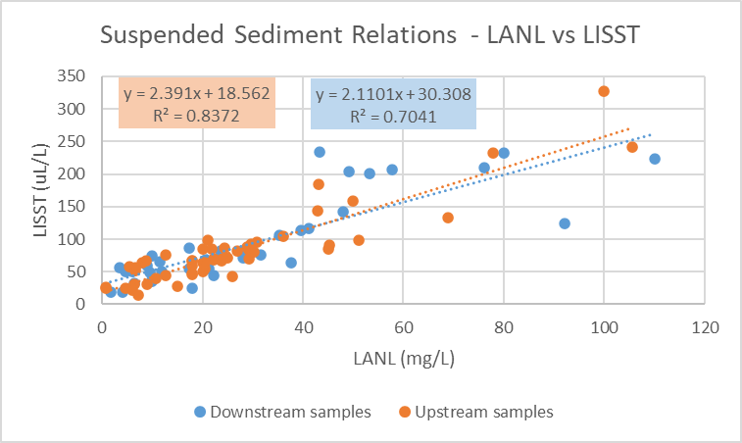
Results: Comparing concentrations directly
DOWNSTREAM REACH
Date_Time | SS (mg/L) | SS (uL/L)
8/3/2022 15:02 | 57.73 | 206.82
8/3/2022 15:17 | 48.06 | 142.53
8/3/2022 15:47 | 17.43 | 55.06
8/3/2022 16:17 | 11.45 | 66.04
8/8/2022 14:28 | 49.09 | 204.03
8/8/2022 14:43 | 35.39 | 105.77
8/8/2022 15:23 | 23.68 | 68.83
8/8/2022 16:13 | 9.89 | 36.65
8/8/2022 16:58 | 4.08 | 19.05
8/8/2022 17:28 | 1.65 | 18.36
4/18/2023 0:30 | 8.95 | 59.16
4/18/2023 4:30 | 9.5 | 48.47
4/19/2023 2:30 | 10 | 74.75
4/19/2023 12:30 | 3.5 | 56.59
4/30/2023 23:00 | 17.42 | 85.89
5/1/2023 14:00 | 6 | 50.13
5/1/2023 20:00 | 22.14 | 44.99
5/2/2023 3:00 | 10 | 35.73

Slide 6
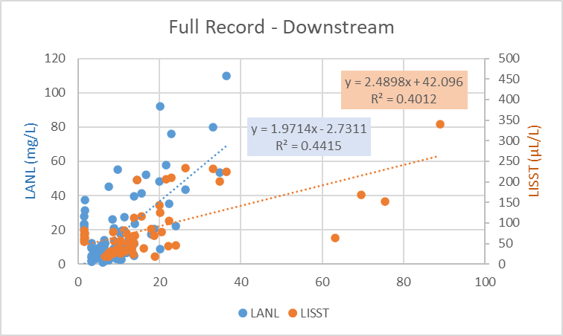
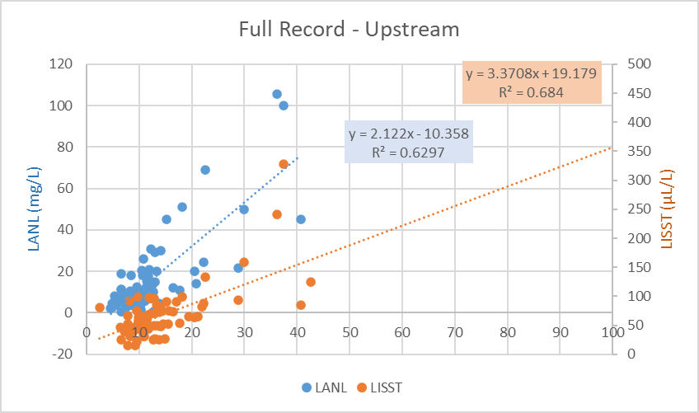
Results: Turbidity and SS
The problem with this is the inconsistency with the UNITS:
Spring 2023 units are NTU
Summer samples are FNU
All p-values < 0.05 Significant!

Slide 7
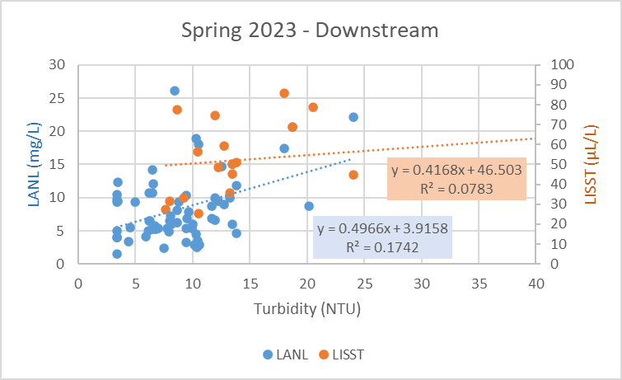
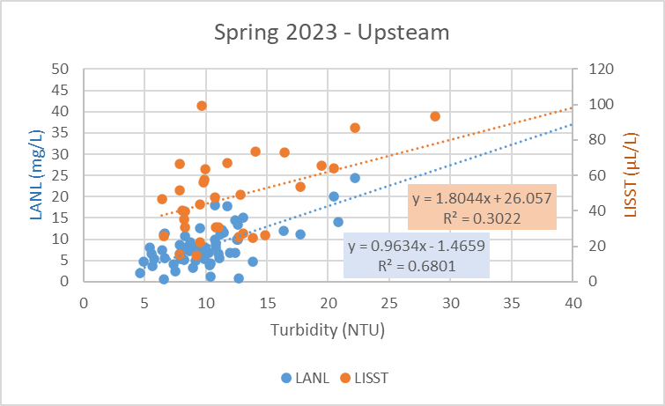
Results: Turbidity and SS – Spring 2023
Downstream - Spring 2023
 | Coefficients | Standard Error | t Stat | P-value
Intercept | 3.916 | 1.368 | 2.862 | 0.006
Turbidity | 0.497 | 0.137 | 3.616 | 0.001
Upstream - Spring 2023
 | Coefficients | Standard Error | t Stat | P-value
Intercept | -1.466 | 1.058 | -1.385 | 0.171
Turbidity | 0.963 | 0.085 | 11.295 | 0.000
Downstream - Spring 2023
 | Coefficients | Standard Error | t Stat | P-value
Intercept | 46.503 | 7.228 | 6.434 | 0.000
Turbidity | 0.417 | 0.358 | 1.166 | 0.261
Upstream - Spring 2023
 | Coefficients | Standard Error | t Stat | P-value
Intercept | 26.057 | 7.252 | 3.593 | 0.001
Turbidity | 1.804 | 0.492 | 3.664 | 0.001

Slide 8
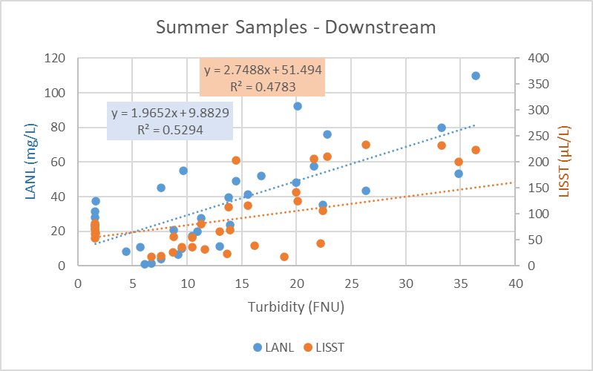
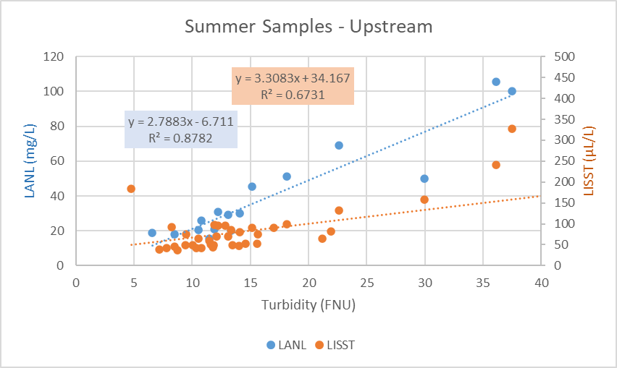
Results: Turbidity and SS – Summer Samples
Downstream - Summer
 | Coefficients | Standard Error | t Stat | P-value
Intercept | 9.883 | 5.296 | 1.866 | 0.071
Turbidity | 1.965 | 0.328 | 6.000 | 0.000
Upstream - Summer
 | Coefficients | Standard Error | t Stat | P-value
Intercept | -6.711 | 5.371 | -1.250 | 0.232
Turbidity | 2.788 | 0.278 | 10.048 | 0.000
Downstream - Summer
 | Coefficients | Standard Error | t Stat | P-value
Intercept | 56.142 | 14.692 | 3.821 | 0.001
Turbidity | 2.416 | 0.610 | 3.962 | 0.000
Upstream - Summer
 | Coefficients | Standard Error | t Stat | P-value
Intercept | 34.167 | 9.885 | 3.457 | 0.001
Turbidity | 3.308 | 0.379 | 8.729 | 0.000

Slide 9
Questions about my data…
Why are the summer relationships so much better than the spring?
Are these correlations good enough to transform my turbidity record into suspended sediment concentrations?
Is there anything I can I do to fix or be able to use the spring relationships?
Am I missing any key information about all this?????

